Slide 1


Slide 2
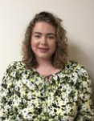

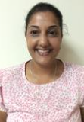
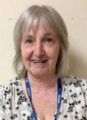
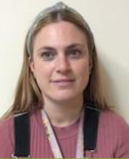
Year 3 Team
Teachers:
Miss Palmer Mrs Nnebi
Teaching assistants/Learning support:
Miss Sagoo
Miss Butler
Miss Harper

Slide 3
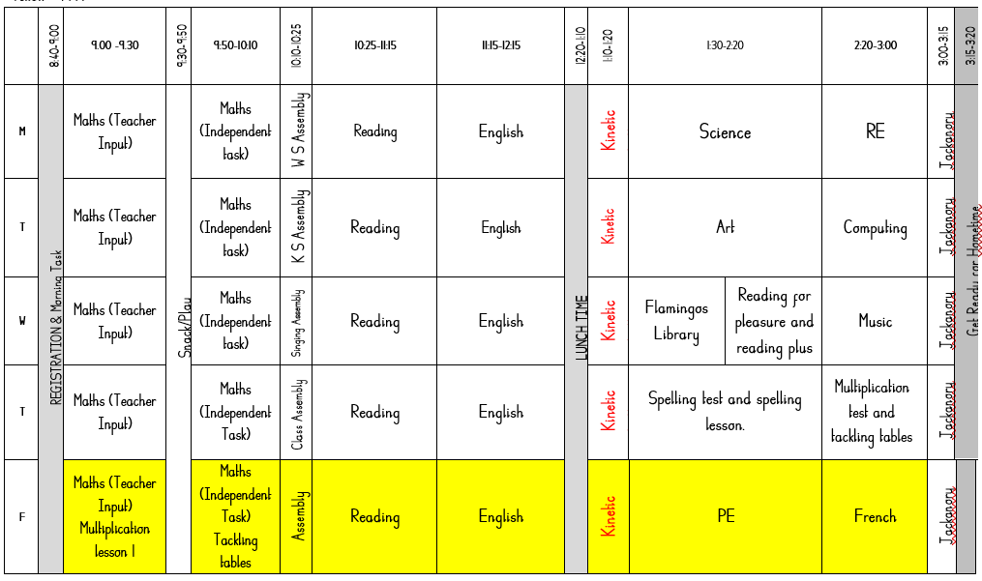
Example timetable

Slide 4
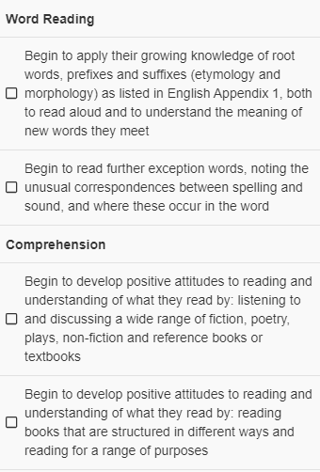
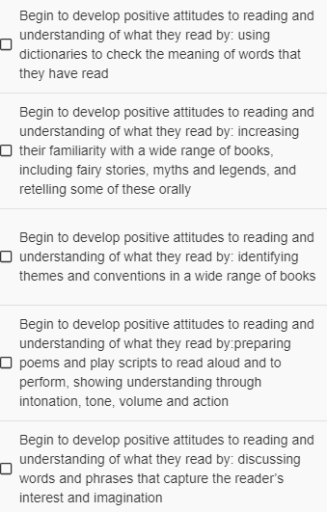
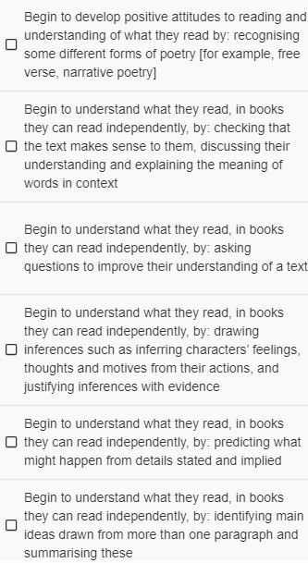
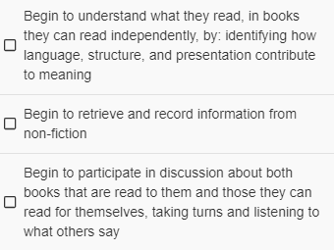
Year 3 CORE skills- Reading

Slide 5
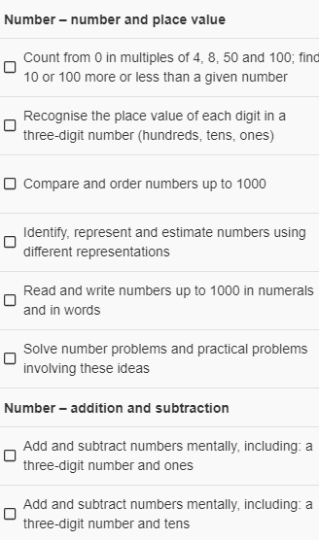
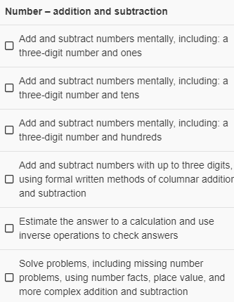
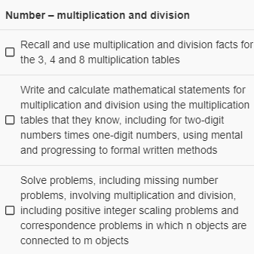
Year 3 CORE skills- Maths

Slide 6
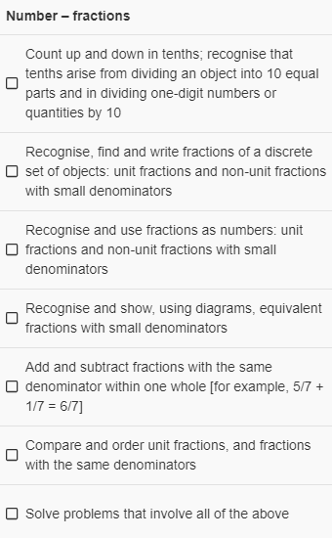
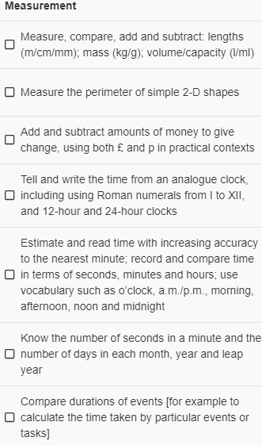
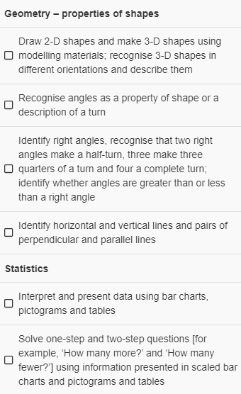
Year 3 CORE skills- Maths

Slide 7
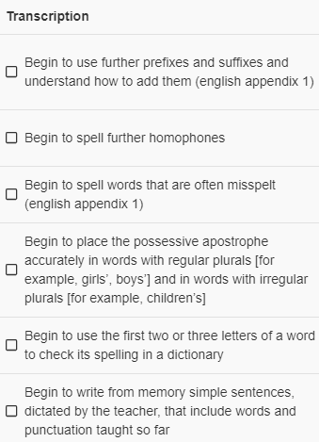
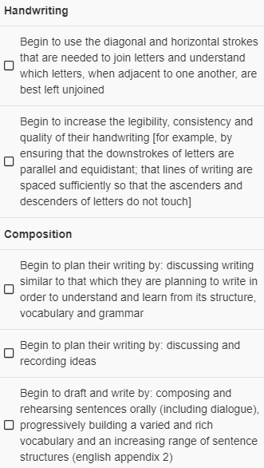
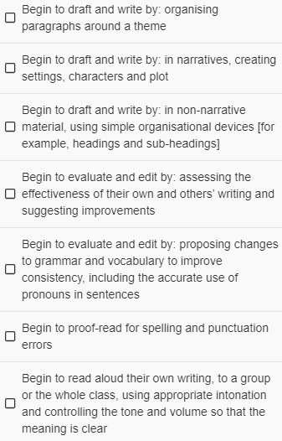
Year 3 CORE skills- Writing

Slide 8
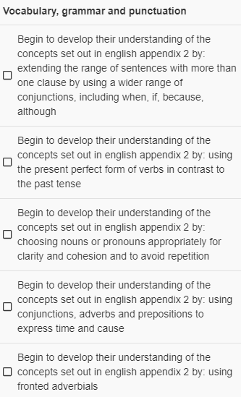
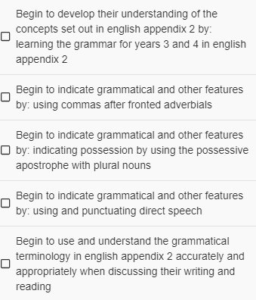
Year 3 CORE skills- Writing

Slide 9
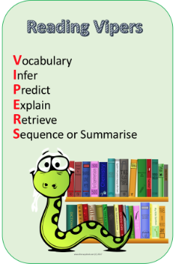
Reading
Flamingos and Parrots go to the library on a Wednesday afternoon.
Books will be changed on a Friday, updated in their reading records.

Slide 10

RWI-
Read Write Inc (RWI) is a programme to get children off to a flying start with their literacy. RWI is a method of learning based upon letter sounds and phonics, and we use it to aid children in their reading and writing.
Some children will go to RWI during reading lessons to strengthen their phonic knowledge and/or their comprehension skills.

Slide 11
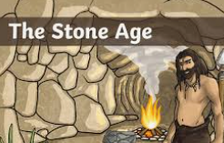
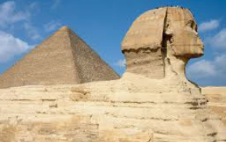

Our three curriculum topics
Autumn Term-
The Stone Age.
Spring Term
Egypt and the Egyptians.
Summer Term
Our planet and water.

Slide 12
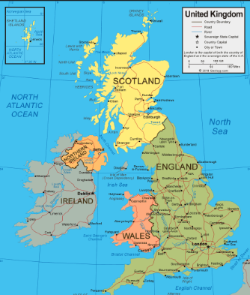
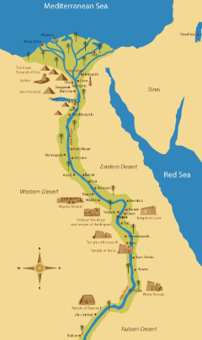

The wider curriculum- Geography
During the year in Geography, the children will be learning about
Autumn
The United Kingdom – capital cities, atlas’, population and settlement.
Spring
The Rive Nile – Why is it important for Egyptians past and present.
Summer
Our planet – How to look after it and keep it safe/healthy.

Slide 13
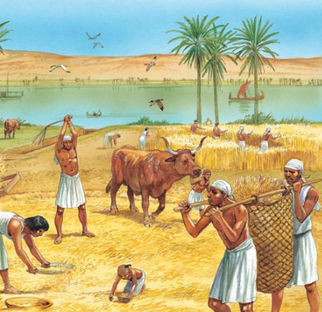
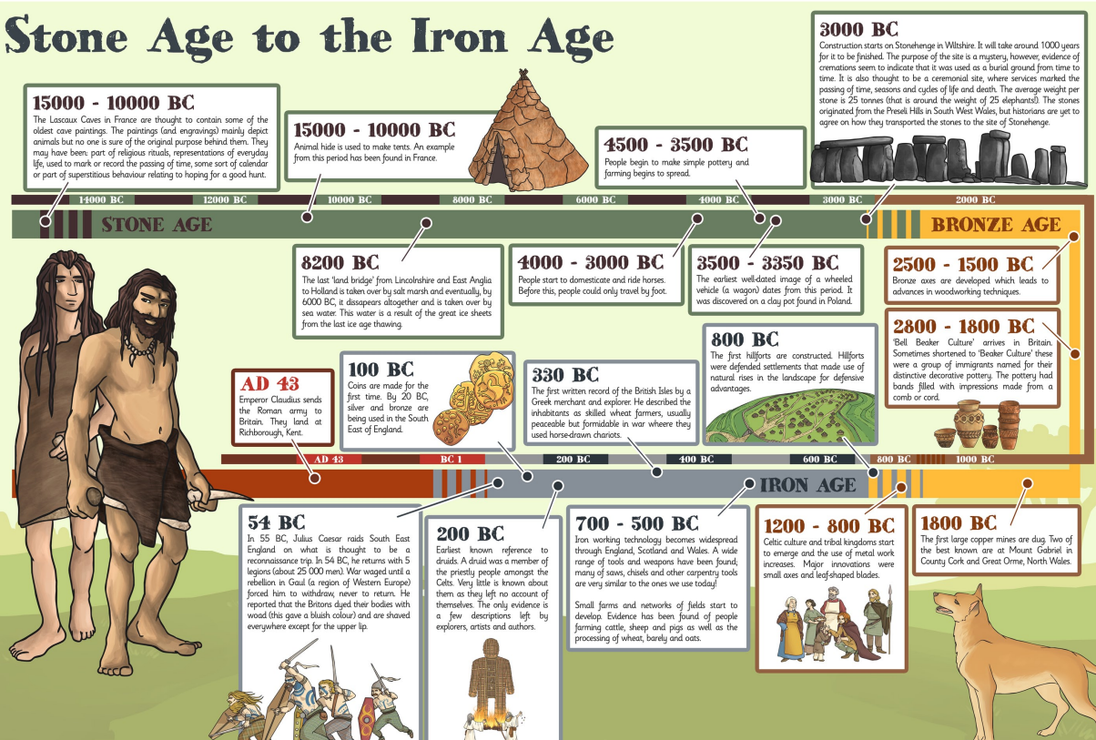
The wider curriculum- History
During the year in History, the children will be learning about
Autumn
The Stone Age - What changed and what stayed the same from Stone Age to Iron Age Britain?
Spring
Egypt – What were the significant achievements of the Egyptians?

Slide 14
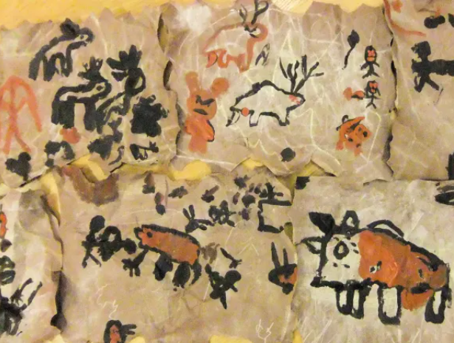
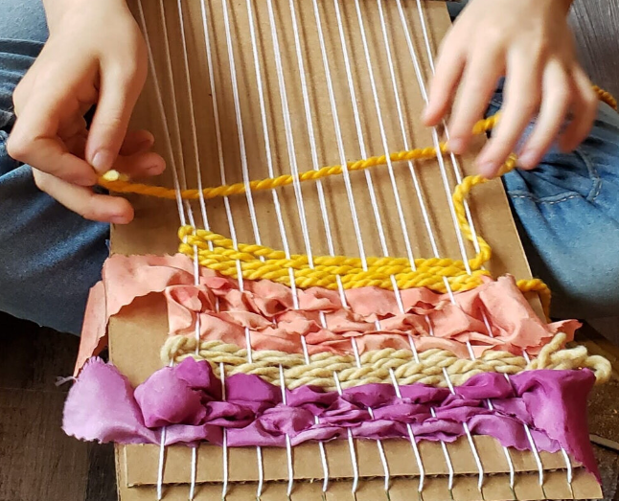
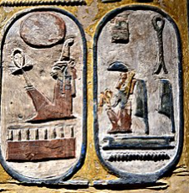
The wider curriculum- Art
During the year in Art, the children will be learning about
Autumn
Cave paintings.
Spring
Egyptian cartouche.
Summer
Weaving.

Slide 15
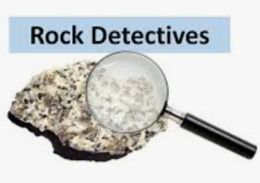
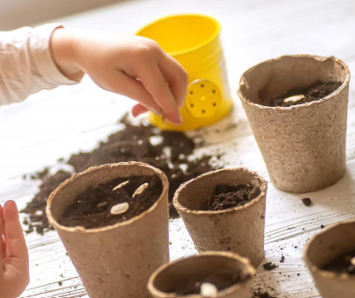


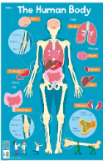
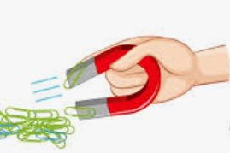
The wider curriculum- Science
During the year in Science, the children will be learning about
Autumn – Rock Detectives and Amazing Bodies
Spring – Forces and How Does Your Garden Grow?
Summer – Can You See Me?

Slide 16


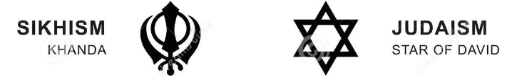
The wider curriculum- RE
During the year in RE, the children will be learning about
Autumn
Christianity.
Spring
Islam.
Christianity – The Easter story.
Summer
Sikhism
Judaism
Hinduism.

Slide 17

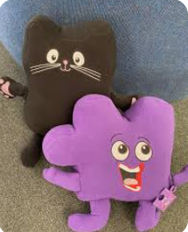
The wider curriculum- RSHE
During the year in RSHE, the children will be learning about
BM (Being Me in My World)
'Who am I and how do I fit?'
CD (Celebrating Difference)
Respect for similarity and difference. Anti-bullying and being unique
DG (Dreams and Goals)
Aspirations, how to achieve goals and understanding the emotions that go with this.
HM (Healthy Me)
Being and keeping safe and healthy
RL (Relationships)
Building positive, healthy relationships
CM (Changing Me)
Coping positively with change

Slide 18
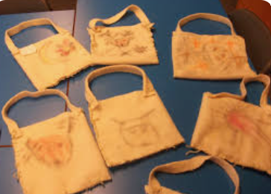
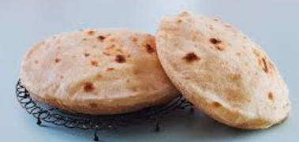
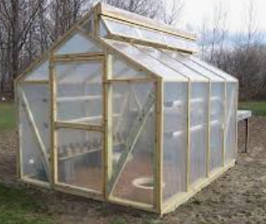
The wider curriculum- DT
During the year in DT, the children will be learning about
Autumn
Sewing – a Stone Age pouch.
Spring
Cooking - Egyptian bread.
Summer
Sawing - build your own greenhouse.

Slide 19
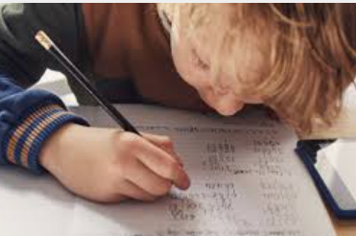

Home Learning
Homework will be given out weekly, every Friday.
It needs to be returned by Thursday each week so the children can self-mark their homework as a morning task.
Children will be expected to complete homework during lunchtime in catch up club on a Thursday if not returned.

Slide 20





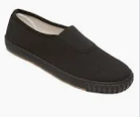
PE
PE Kit (in a bag clearly labelled with your child’s name) – White or yellow polo shirt/ t-shirt or vest top, black shorts/tracksuit bottoms/leggings, black pumps or trainers.
When your child is learning an outside sport you can expect them to be going outside, as long as the weather is not adverse. Please make sure that they have a tracksuit and or suitable outdoor PE kit.

Slide 21
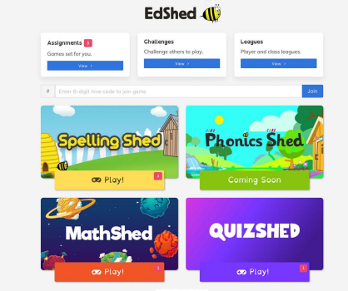
Spelling Shed instructions
Log in using the username and password or scannable QR code and it will take you to this screen. The pink notification boxes indicate how many assignments have been set by the teacher and on which game. If you click on the assignments box at the top of the menu, you can see all of the assignments together.

Slide 22
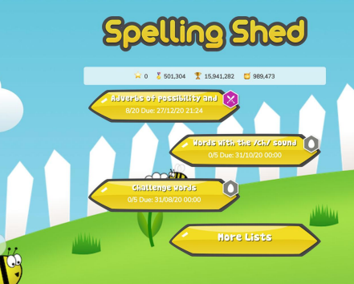
Spelling Shed instructions
To get to the Spelling Shed games, click on Spelling Shed and you will see a screen that looks like this. This screen shows the assignments that have been set by the teacher. The assignments link to games that include the words that need to be learnt or practiced. The icons or badges on the assignments show different achievement levels and are an incentive for the children to play more and aim for the top level. They are also a quick way for teachers to see how well they can spell the words in the lists.

Slide 23
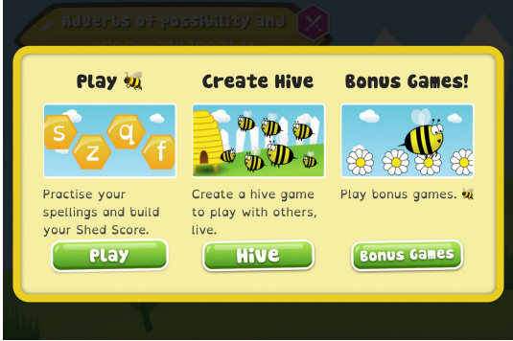
Spelling Shed instructions
When you click on an assignment, you will see three game options that look like this. When completing an assignment, you must use one of the first two game options, Playing the bonus games will not contribute towards the set assignment.

Slide 24
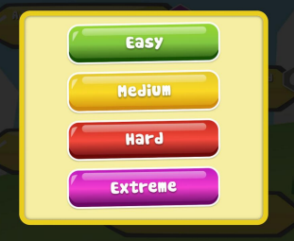
Spelling Shed instructions
Play When you click ‘Play’, four difficulty options will appear.
Easy - You will be shown the word as well as hearing it and you will only see the letters you need to spell it.
Medium - You can listen to the word and you will only have the letters you need.
Hard - You can listen to the word but you will have a few extra letters added
Extreme - You will hear the word and you have a full keyboard of letters These levels of difficulty apply to solo and hive games.
Games completed on easier levels will give the player a lower score and lower ranking. The teacher will be able to see which levels have been chosen for each game.

Slide 25
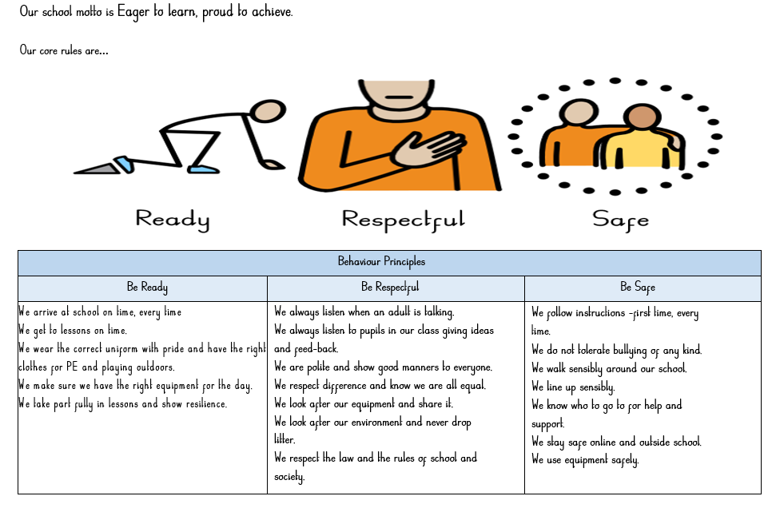
Behaviour

