Slide 1


Slide 2
Year 6 Team
Leopards
Miss Hadley
Mrs. Lawlor
Ms. Glover
Tigers
Mrs. Poolton
Ms. Allen
Miss Jacques
Lions
Mr. Sefton
Mrs. Mann

Slide 3
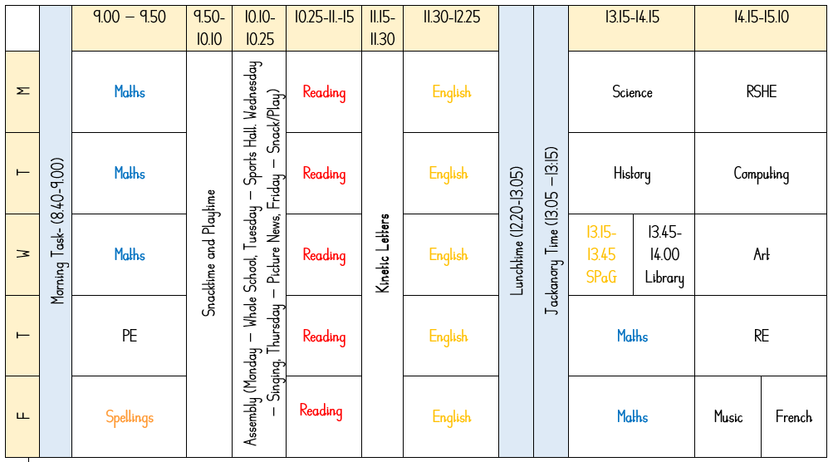
Example timetable

Slide 4

Year 6 CORE skills- Reading
Understand what they read by: drawing inferences such as inferring characters’ feelings, thoughts and motives from their actions, and justifying inferences with evidence
Understand what they read by: predicting what might happen from details stated and implied
Understand what they read by: summarising the main ideas drawn from more than one paragraph, identifying key details that support the main ideas
Retrieve, record and present information from non-fiction
Provide reasoned justifications for their views

Slide 5
Reading
Year 6’s library day is Wednesday. Library books need to be brought in on this date, in order for them to be changed.
Reading records will also need to be returned on Wednesday.
When these are returned, we will then change the children’s home readers.

Slide 6
Year 6 CORE skills- Maths
Read, write, order and compare numbers up to 10 000 000 and determine the value of each digit
Round any whole number to a required degree of accuracy
Use negative numbers in context, and calculate intervals across zero
Use their knowledge of the order of operations to carry out calculations involving the four operations
Use common factors to simplify fractions; use common multiples to express fractions in the same denomination
Add and subtract fractions with different denominators and mixed numbers, using the concept of equivalent fractions
Solve problems involving the calculation and conversion of units of measure, using decimal notation up to three decimal places where appropriate

Slide 7
Year 6 CORE skills- Writing
Use dictionaries to check the spelling and meaning of words
Write legibly, fluently and with increasing speed by: choosing which shape of a letter to use when given choices and deciding whether or not to join specific letters
Plan their writing by: noting and developing initial ideas, drawing on reading and research where necessary
Draft and write by: in narratives, describing settings, characters and atmosphere and integrating dialogue to convey character and advance the action
Evaluate and edit by: proposing changes to vocabulary, grammar and punctuation to enhance effects and clarify meaning
Proof-read for spelling and punctuation errors

Slide 8
Our three curriculum topics
Autumn Term- ‘A Turning Point in Time’. This is a historical and geographical focus on World War 2.
Spring Term – ‘Welcome to the Jungle’. This is a scientific and geographic focus on the Amazon Rainforest and Brazil.
Summer Term – ‘This is Me, Moving On’. This is an R.S.H.E. based focus, where we delve deeper into pupils’ feelings towards secondary school and how they will feel to be leaving primary school.

Slide 9
The wider curriculum- Geography
During the year in Geography, the children will be learning about
Autumn – The geography of WW2, which countries were involved and where they are located.
Spring – The geography of Brazil and South America, including a look into how people in Brazil live and how this differs to the United Kingdom.
Summer – The natural resources that are available to us in our local area and the United Kingdom.

Slide 10
The wider curriculum- History
During the year in History, the children will be learning about
Autumn – How World War 2 impacted the United Kingdom, specifically the children, focusing on rationing and evacuation to the countryside.
Spring – a double unit, about the Ancient Maya civilisation, their greatest achievements and their lasting legacy on our society today.

Slide 11
The wider curriculum- Art
During the year in Art, the children will be learning about
Autumn – Children will learn about using different lines to recreate L.S. Lowry’s famous ‘VE day’ drawing.
Spring – We will learn about Henri Rosseau’s jungle drawings and look at the composition of art pieces, eventually recreating his ‘Surprised!’ piece.
Summer – A manga focus. Children will use iPads to research and create digital art in the style of Yuu Watase’s ‘Fushigi Yuugi’.

Slide 12
The wider curriculum- Science
During the year in Science, the children will be learning about
Autumn – Classification of living things and evolution of species & inheritance
Spring – Human circulation and electricity
Summer – Body health and light

Slide 13
The wider curriculum- RE
During the year in RE, the children will be learning about
Autumn Children will look at the question ‘What would Jesus do?’ linked to Christianity. We will also look at the idea of how people believe that religion can help when times are hard.
Spring Children will look at Christian Aid and Islamic Relief along with asking the question ‘What will make Sandwell a more respectful community?’
Summer - Children will look at Hindu, Jewish and Islamic prayer along with asking the question What impact do people’s beliefs have in their lives?

Slide 14
The wider curriculum- RSHE
During the year in RSHE, the children will be learning about
Autumn 'Who am I and how do I fit?’
Respect for similarity and difference. Anti-bullying and being unique
Spring Aspirations, how to achieve goals and understanding the emotions that go with this.
Being and keeping safe and healthy
Summer Building positive, healthy relationships
Coping positively with change

Slide 15
The wider curriculum- DT
During the year in DT, the children will be learning about
Autumn A Turning Point in Time where children will construct an Anderson Shelter.
Spring Welcome to the Jungle where children will design and sew a Poison Dart Frog.

Slide 16
Home Learning
Homework this year will focus on a short Maths, SPaG and Handwriting task, as well as instructions to use Spelling Shed and Tackling Tables.
It will be given out on a Friday. Homework should be returned by Thursday. If it not complete, children will complete it at break time on Friday.
As we get closer to SATs, there will also be opportunity to complete additional revision.

Slide 17
PE
P.E. is on a Thursday.
PE uniform is a plain white t shirt, plain black joggers and black shoes. Children are also welcome to wear their school jumper, or an appropriate plain jumper on P.E. days. Please be reminded that children are not permitted to wear football kits.

Slide 18
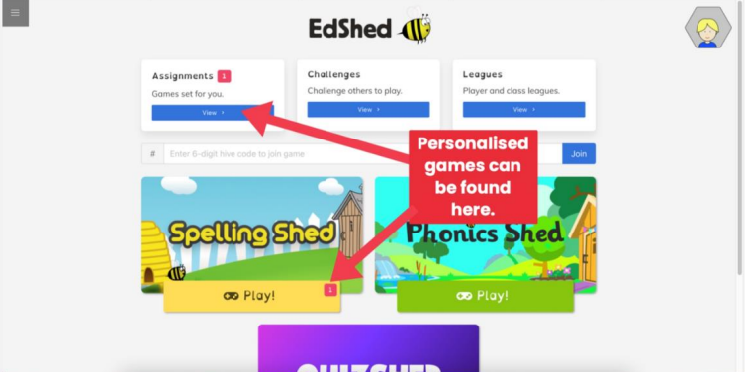
Spelling Shed

Slide 19
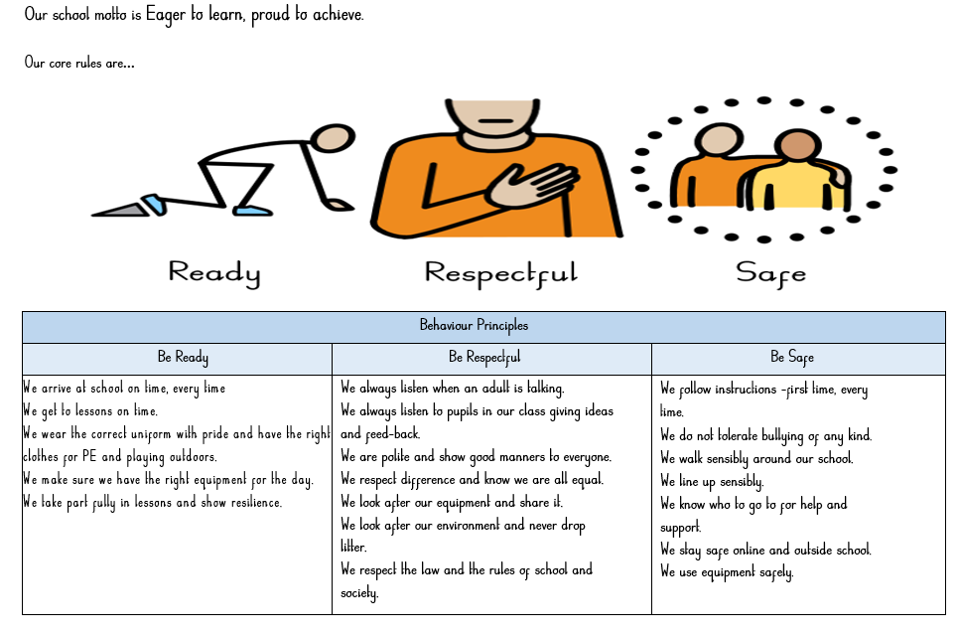
Behaviour

