Slide 1


Slide 2

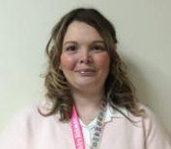

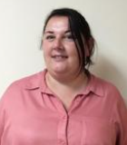
Year 2 Team
Mrs Hickman
Foxes class teacher
Miss Dhanjal
Badgers class teacher
Mrs Hall
Cover supervisor
Mrs Pickard
Learning Support
Mrs Jenkins
Learning Support
Mrs Pyatt-Payne Learning Support

Slide 3
Example timetable

Slide 4
Year ? CORE skills- Reading
Screen shot objectives from Insight

Slide 5
Year ? CORE skills- Maths
Screen shot objectives from Insight

Slide 6
Year ? CORE skills- Writing
Screen shot objectives from Insight

Slide 7
Reading
Day you go to the Library
Day that reading records need to returned
Day that books will be changed

Slide 8
RWI- If applicable

Slide 9
Our three curriculum topics
Autumn Term-
Spring Term
Summer Term

Slide 10
The wider curriculum- Geography
During the year in Geography, the children will be learning about
Autumn
Spring
Summer

Slide 11
The wider curriculum- History
During the year in History, the children will be learning about
Autumn
Spring
Summer

Slide 12
The wider curriculum- Art
During the year in Art, the children will be learning about
Autumn
Spring
Summer

Slide 13
The wider curriculum- Science
During the year in Science, the children will be learning about
Autumn
Spring
Summer

Slide 14
The wider curriculum- RE
During the year in RE, the children will be learning about
Autumn
Spring
Summer

Slide 15
The wider curriculum- PSHE
During the year in PSHE, the children will be learning about
Autumn
Spring
Summer

Slide 16
The wider curriculum- DT
During the year in DT, the children will be learning about
Autumn
Spring
Summer

Slide 17
Home Learning
Information about homework
When it will be given out and returned.

Slide 18
PE
Days PE are on
PE uniform

Slide 19
Spelling Shed instructions
Screen shot of how to use

Slide 20
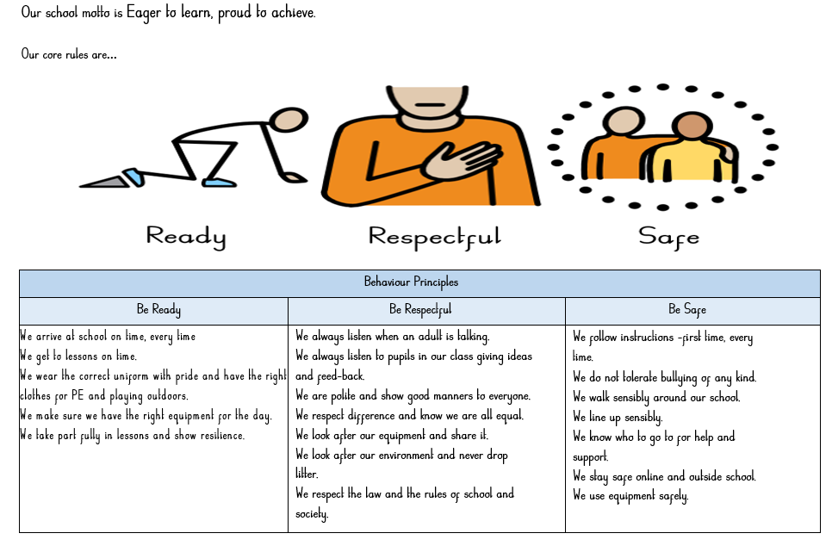
Behaviour

