Slide 1

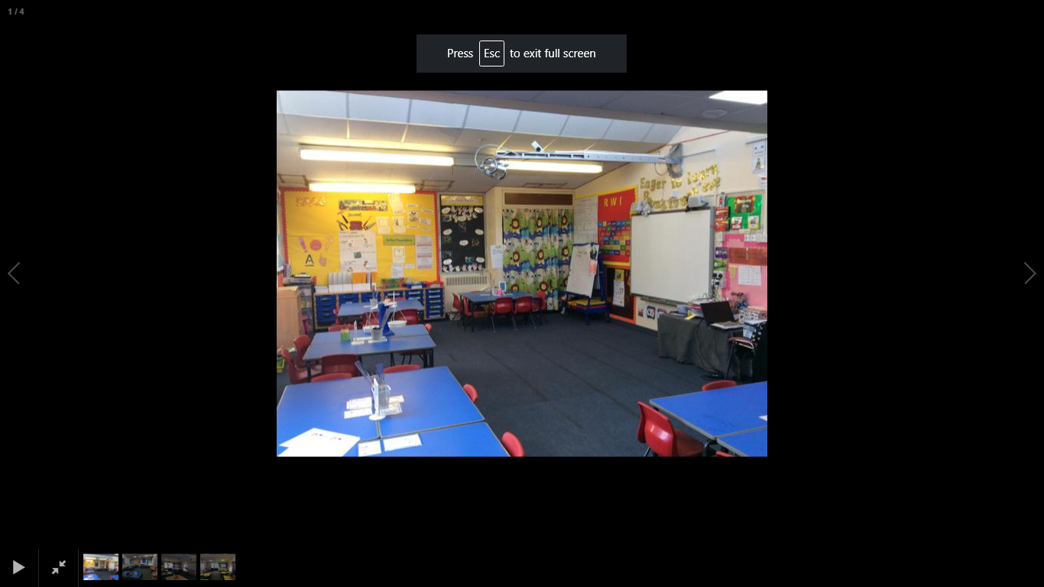
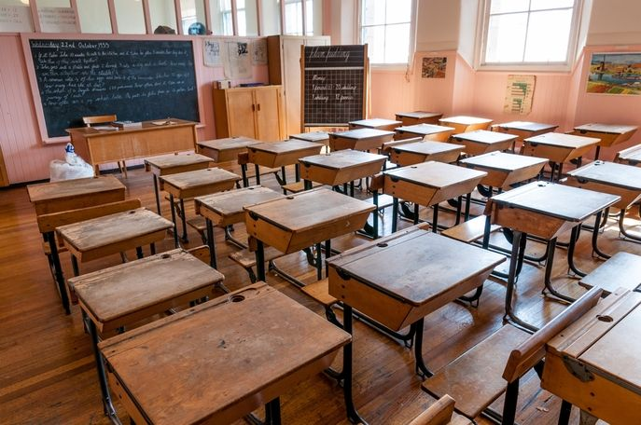

History Knowledge Organiser
Year 1– Autumn Term 2
How has schools changed over time?
Key Events Timeline
1974 | 2010 | 2011 | 2012 | 2017
School was built. | Reception classes were made bigger. | School now has 2 halls not just one. | A computer suite was added. | The Muga was built.
We will be learning all about our school and what has changed over time. We will be looking at when our school was built and how it has developed over the years. Using a timeline, we will add events from past and present then compare old and new things that have changed in school.
New skills
Sequence some events or 2 related objects in order of time. Use words and phrases: old, new, now, then, yesterday Tell the difference between past and present in their own lives and other people lives. Listen to eye-witness accounts from grandparents. Begin to suggest why something might be different. Begin to identify some details from the past from pictures. Show knowledge and understanding about the past in different ways.
Tier 2 Vocabulary
Then – Something to follow of from
Now- Something happening immediately
Present- Happening at the time
Past- Something that has already happened
Change- To become different
New- Not been used or has recently arrived
Old- Having existed for many years
Tier 3 Vocabulary
Similarities- Things that may be the same in given ways
Differences- Things that are not the same as others
Compare- To note or describe things that are the same or different
Explain- To give reasons for
Discuss- To talk about a topic

