Slide 1

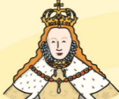
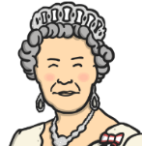
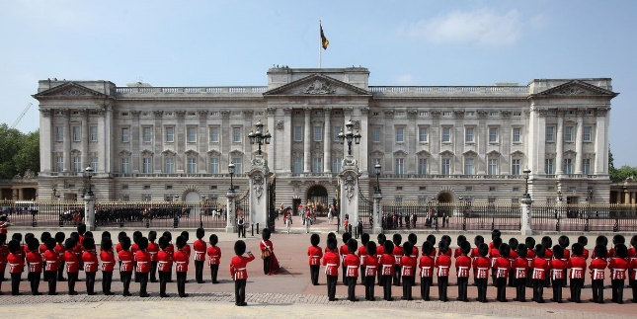
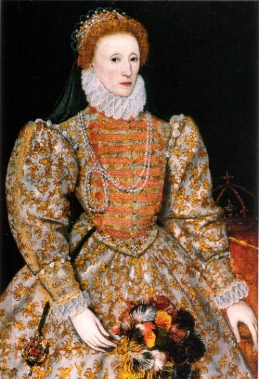
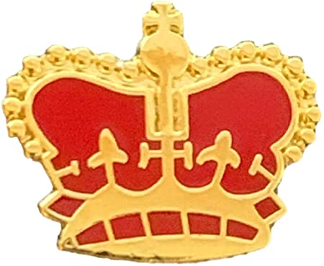
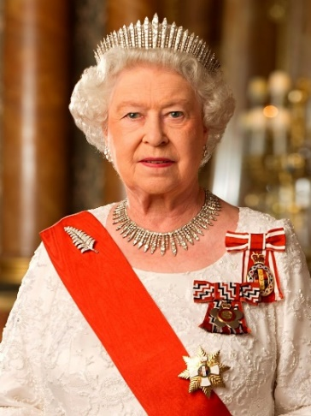

Beyond living memory.
Within living memory.
Buckingham Palace
SKILLS - As historians we are learning to:
Understand chronology
Identify what makes someone significant
Finding the same and different
Ask questions and draw conclusions
Sequence of Lessons
1. To explore who our queen was.
2 To understand the importance of a Jubilee.
3. To identify how our Queen became Queen.
4. To understand the importance of our Queen
5. To understand the role of Parliament.
6. To explain and compare who Queen Elizabeth I and II were.
Elizabeth I
Elizabeth I was Queen of England for 45 years (1558 to 1603). She was born on 7th September 1533 (more than 400 years ago!). Elizabeth I is famous for having red hair. At this time lots of English explorers searched for new lands and treasures. The time when Elizabeth I was Queen is known as Golden Age.
Which Queen Elizabeth was more significant?
Tier 1 Vocabulary
Queen – A woman who rules the country.
Royal – A King or Queen or a member of their family
Rule – One or a set of clear guidelines that needs to be followed.
Government - The people who are in charge of running the country
Anniversary – The date of a special event that returns every year.
Tier 2 Vocabulary
Monarch - A King, Queen or Emperor who rules the country.
Heir – The person who is going to become King or Queen next.
Coronation – When a King or Queen is crowned and starts their reign.
Empire - A group of countries ruled over by one monarch.
Jubilee – A celebration of a special event.
Reign – The amount of time a King or Queen rules.
Elizabeth II
Queen Elizabeth II was the last Queen of Great Britain. Queen Elizabeth II was born on 21 April 1926. She died at 96 years old on 8th September 2022. Her coronation was held at Westminster Abbey on the 2 June 1953. She is the longest reigning monarch ever in Britain.

