Slide 1

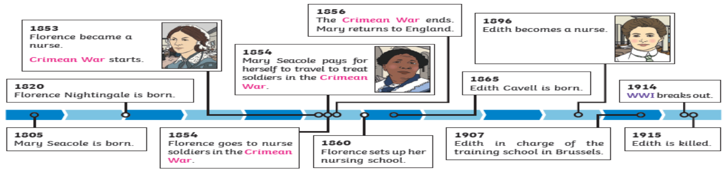
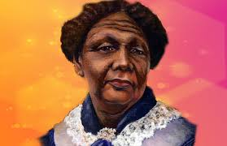
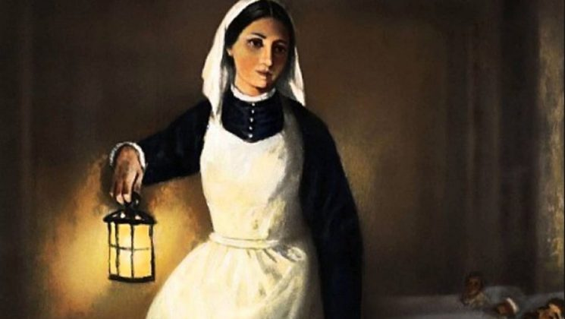
History Knowledge Organiser
Year 2 – Spring Term 1
Who was the most significant nurse?
We will be learning all about the role of Florence Nightingale during the Crimean War, and the impact she has had globally. Then we will explore the role of Mary Seacole in The Crimean War and compare the impacts both nurses had, concluding who was most significant.
New skills
Recount changes in own life over time. Put 3 people, events or objects in order using a given scale Use words and phrases: related to topic vocabulary to do with time
Use a range of sources to describe differences between then and now Recount main events from a significant time in history Use evidence to explain reasons why people acted in the past as they did.
Look carefully at pictures, eye-witness accounts or objects to find information about the past. Ask questions about the source material Say how features of the period influence how events are treated.
Tier 2 Vocabulary
Nursing - healthcare profession focused on caring for individuals, families, and communities to promote health and prevent illness.
Impact - the profound, lasting effects or consequences of past events, people, or ideas.
Globally - relates to the whole world..
Tier 3 Vocabulary
Significant individual – a person that has made an impact globally.
Source - a first-hand account, original document, or artifact created during the time period being studied, offering direct evidence.
Chronology - putting historical events in the order they happened.
Timeline - a visual, chronological map of events, using a line with dates, pictures, and descriptions to show when things happened.
Enquiry - a student-led, question-driven approach where children investigate the past by asking big questions.

