Slide 1

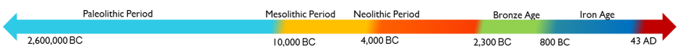
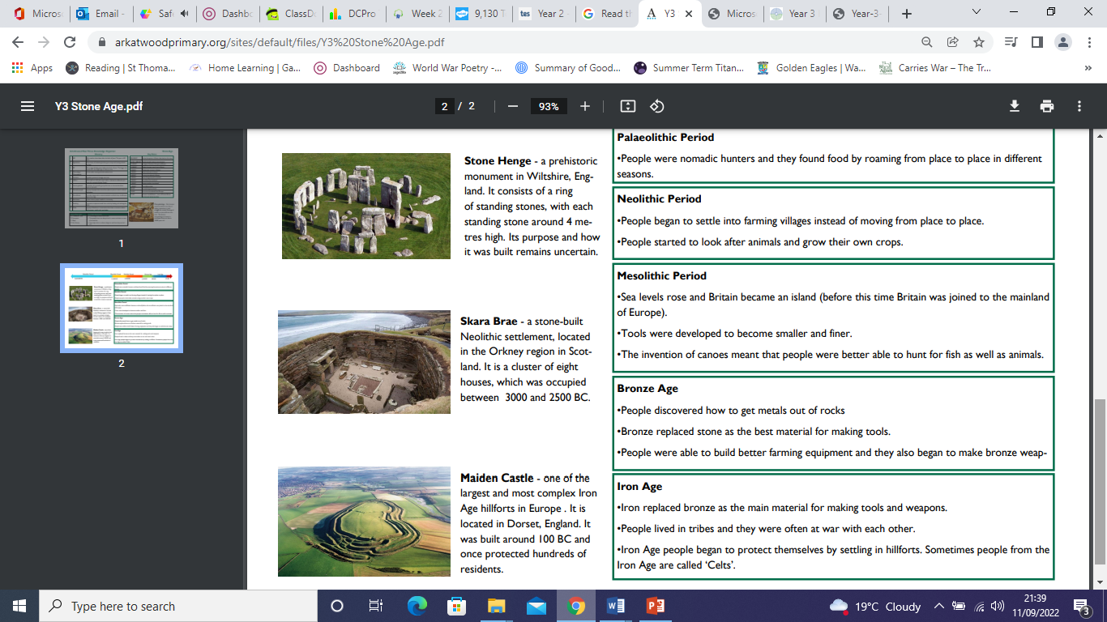
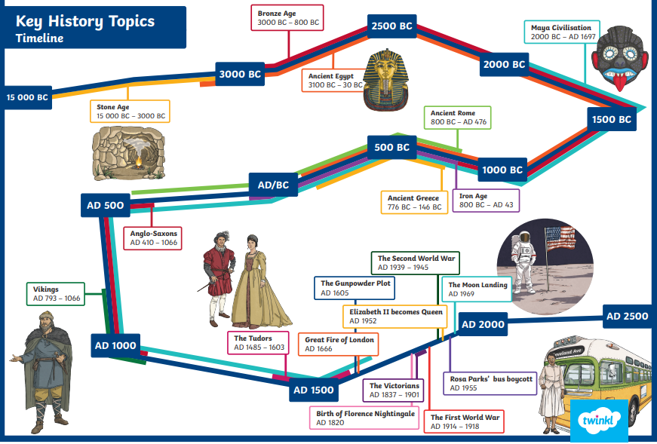
History Knowledge Organiser
Year 3 – Autumn Term 1
Dawn of time - What changed and what stayed the same from Stone Age to Iron Age Britain?
Key Events Timeline
Knowledge and key information: We will learn about the different periods of time: Paleolithic, Mesolithic, Neolithic, Bronze Age and Iron Age. We will know that tools became more sophisticated as the periods progressed.
Tier 2 Vocabulary
Clan- Communities that are part of the same tribe
Tribe – A group of people that share common origins
Settlement – A group of dwellings that form a community
Hunter-gatherer – People who live by hunting, fishing and collecting wild fruit.
Currency – something given in exchange of goods
Monument – A group of huge stone, often set up in a line or circle
Thatched – A thatched house or a house with a thatched roof has roof made of straw or reeds.
Sacrifice – to kill something and offer to Gods
Trade – buying and selling things
New skills
- Use timelines to place events in order - Understand timelines can be divided in BC and AD - Use words and phrases to show chronology: century, decade, interval, scale, duration, sequence - Use evidence to describe houses and settlements, culture and the way of life, people's beliefs and attitudes and differences between rich and poor. - Use evidence to find out how any of these may have changed during a time period - Suggest reasons for why there were differences between periods. - Use a range of source material including visits to collate information about the past.
Tier 3 Vocabulary
Stone Age – A period of time in which people made simple tool, were mostly hunter-gatherers and began to farm and build settlements
Bronze Age – A period of time during which metalwork was introduced
Iron Age – A period of time in which tools were made of iron
Neolithic – The Neolithic is the youngest part of the Stone Age. During this period farming was invented and people started to care for animals such as cows, sheep and pigs.
Flint knapping – The art of creating tools by chipping rocks
Hill fort – Buildings on top of hills, used as settlements and defensive spaces.
Archaeologist – someone who studies ancient sites
Barrow – Stone Age burial site
Prehistory – An account of the past from a time before written records began

