Slide 1

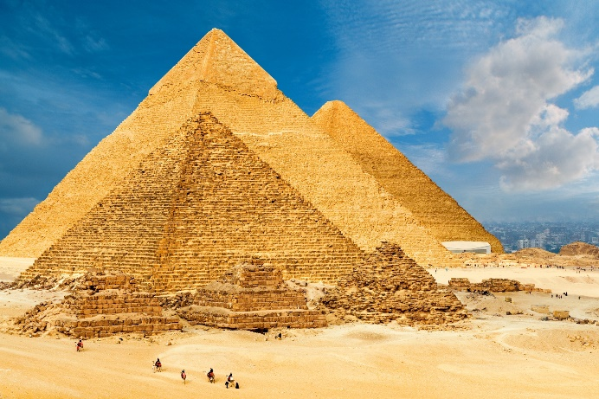
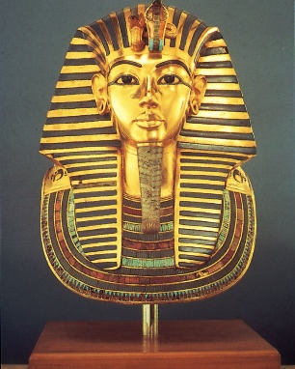
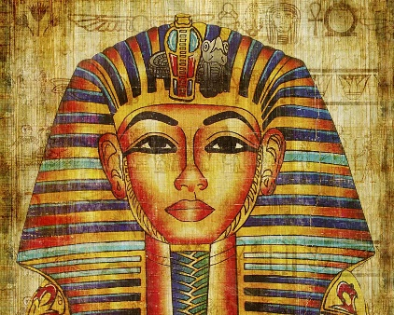
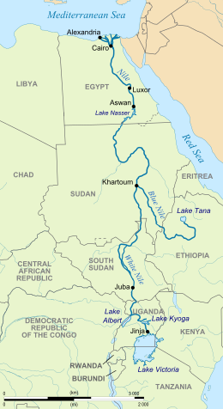
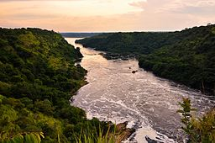
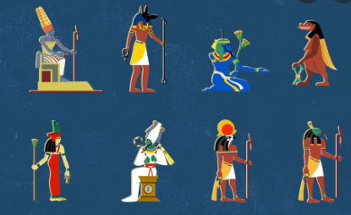
History Knowledge Organiser
Year 3 – Spring 1
What were the significant achievements of the Egyptians?
Key Events Timeline
Significant Achievements/Events Timeline
7500BC – First settlers arrive in the Nile Valley | 5000BC – Egyptians began farming sheep and cattle | 2560BC – The pyramid of Giza was built. | 1332BC – The ten year rule of Tutankhamun begins | 51BC – Cleopatra’s reign begins and the civilisation ends.
Knowledge and key information: We will learn about the achievements of the earliest civilizations – an overview of where and when the first civilizations appeared and a depth study of one of the following: Ancient Sumer; The Indus Valley; Ancient Egypt; The Shang Dynasty of Ancient China
New skills
Use timelines to place events in order Understand timelines can be divided in BC and AD Use words and phrases to show chronology: century, decade, interval, scale, duration, sequence Identify significant events Understand limitations of sources Extracting information from sources Locate answers to own questions
Tutankhamun and Cleopatra are two of the most recognised pharaohs.
Tier 2 Vocabulary | Tier 3 Vocabulary
Duration – how long something lasts | Canopic Jars – Special jars that held organs of a mummy.
AD – A date after the year 0. | Hieroglyphics – a system of writing using pictures as letters
BC – Used to show a date before the year 0. | Mummification – process of preserving a body for afterlife
Pyramid – A 3D shape built by the Egyptians. | Afterlife- life after death.
Ancient – old/a long time ago. | Pharaoh – an ancient ruler of Egypt
Religion - set of beliefs that is held by a group of people. | Archaeology - the study of things that people made, used, and left behind.
Duration – how long something lasts. | Civilisation - group of people with their own languages and way of life.
Pharaohs were mummified and buried in pyramids.
Egyptians believed in many Gods. The Gods heavily impacted their daily lives.
The river Nile was essential to life in ancient Egypt. Most people lived around this.

