Slide 1

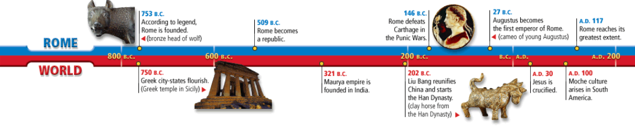
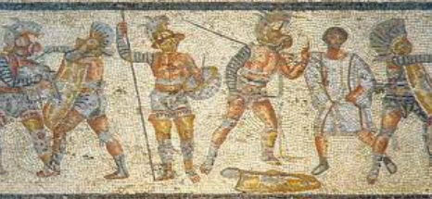
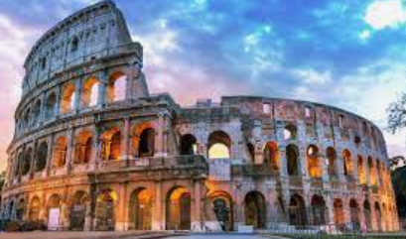


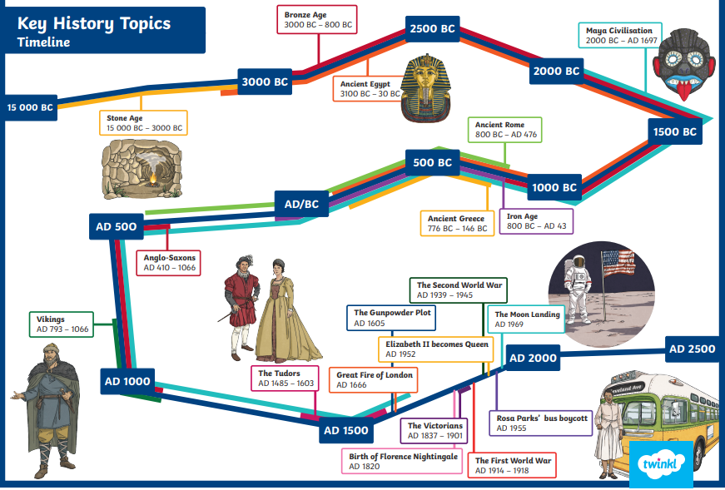
History Knowledge Organiser
Year 4 – Autumn 1
The Romans - How did the Roman empire change over time? What impact did the Roman invasion have on Britain?
Key Events Timeline
Knowledge and key information:. We will explore the Iron age in more detail building up what you have previously learnt in year 3. We will learn about the impact of the Roman invasion the drastic changes that took place in Britain as a result.
Tier 3 Vocabulary
Military – soldiers who form an army to serve their country.
Conquer – to take control by military force.
Invade – to enter a place in large numbers to take power and control.
Empire – a large group of states rules by a Monarch or a sovereign state. (The Roman Empire)
Chronological – ordering events in the order they occurred.
BC/AD – Before Christ and Year of the Lord.
Gladiator – a man trained to fight with weapons.
Aqueduct – an artificial channel to support the flow of water.
Legion – a division of 3000 – 6000 men with a cavalry in the Roman Army.
Tier 2 Vocabulary
Italy – a country located in the middle of the Mediterranean sea.
Rome – Capital city found in Italy.
Invasion – forcing your way into a country with armed force.
Europe – a continent found between the Pacific and Atlantic oceans.
Politics – activities associated with the government who set rules and guidance.
Achievements – completing something with skill and success.
Culture – ideas, customs and social behaviours of a group of people in society.
Decade – a period of 10 years.
New skills
- Name and place dates of significant events of the period on a timeline. - Understand timelines can be divided in BC and AD - Use words and phrases to show chronology: century, decade, interval, scale, duration, sequence - Identify some ideas, beliefs and attitudes of past cultures giving reason for these differences. - Use evidence to describe houses and settlements, culture and the way of life, people's beliefs and attitudes and differences between rich and poor. - Use evidence to find out how any of these may have changed during a time period - Suggest reasons for why there were differences between periods. - Use a range of source material including visits to collate information about the past.

