Slide 1

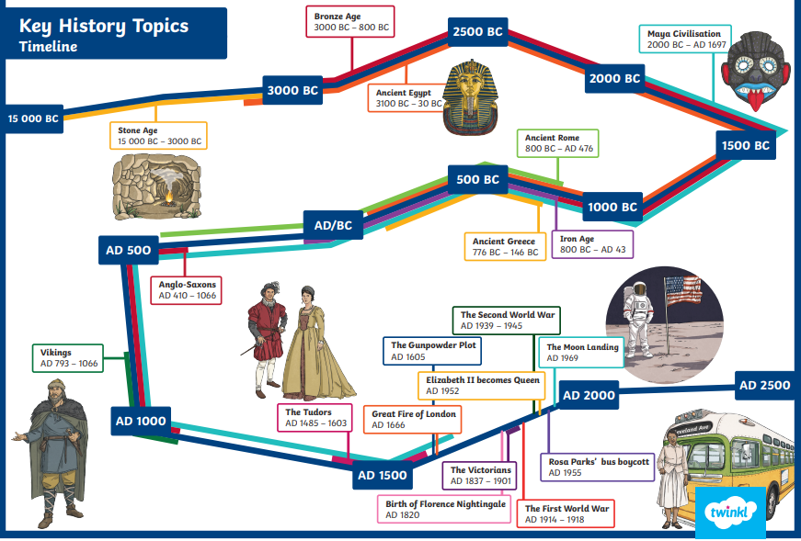
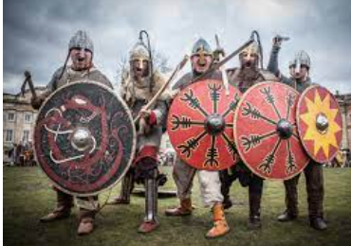
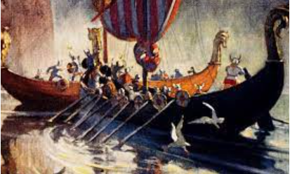
History Knowledge Organiser
Year 4 – Spring 2
Were the Vikings traders or raiders?
Key Events Timeline
Knowledge and key information:. In this topic you will explore the raids and invasions by Vikings in Anglo-Saxon Britain. You will learn who the Vikings were as well as when and where they raided and settled. We will discuss significant events from the period and order these chronologically on a timeline. You will have the opportunity find out about the Anglo-Saxon kings who ruled during the 'Viking Age' and examine their influence and significance in British history.
New skills
- Name and place dates of significant events of the period on a timeline. - Understand timelines can be divided in BC and AD - Use words and phrases to show chronology: century, decade, interval, scale, duration, sequence - Identify some ideas, beliefs and attitudes of past cultures giving reason for these differences. - Use evidence to describe houses and settlements, culture and the way of life, people's beliefs and attitudes and differences between rich and poor. - Use evidence to find out how any of these may have changed during a time period - Suggest reasons for why there were differences between periods. - Use a range of source material including visits to collate information about the past.
Tier 2 Vocabulary
Invade – Enter a county to occupy it.
Settle - A group of people who have settled
Traders – A person who buys and sells goods
Raiders – A person who attacks an enemy in their territory
King – A male ruler of a state or kingdom
England – The largest division of the United Kingdom
Viking – A group of people in the 8th – 11th Century
Tier 3 Vocabulary
Conqueror – Overcome to take control of places or people
Treaty – An agreement between important people
Coexist – To exist (live) in the same place
Eradicate – To destroy something completely
Monasteries- A building occupied by people believing in the same religion
Noble – belonging by rank, having high moral principles
Pagan – believing in more than one religion, not the normal religions

