Slide 1

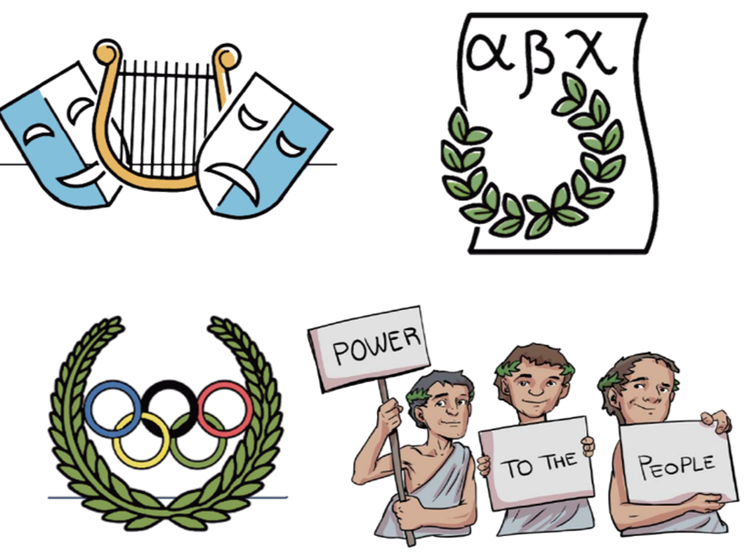

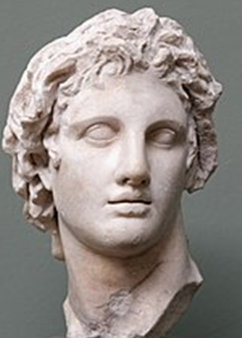
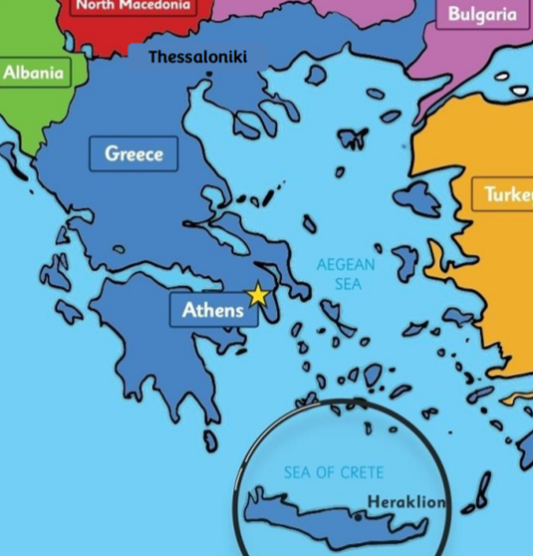
History Knowledge Organiser
Year 5 – Spring
The Greeks - How did the Greeks significantly influence modern Britain?
Key Events Timeline
Ancient Greek Timeline of Key Events
776 B.C. | 700 B.C. | 508 B.C. | 500 B.C. | 472 B.C. | 460 B.C. | 432 B.C. | 331 B.C | 146 B.C.
The first Olympic Games are held in honour of the Greek God Zeus. | Homer writes the Odysseys and Iliad poems. | Male citizens of Athens are given the right to vote- introducing democracy. | The ‘Classical’ period starts, increasing interest in art and architecture. | Greek theatres become popular in Athens. | Hippocrates is born in Kos. He later developed new ideas which helped develop medicine into what it is today. | The Parthenon is completed in Athens. This is an iconic Greek temple built for the Goddess Athena. | Alexander the Great defeats the Persians. | Rome invades and conquers the Corinthians. Greece falls under the rule of the Roman Empire.
Knowledge and key information: This topic allows pupils to build their chronological understanding and allows them to expand their understanding of British and world history. It follows on from the concept of expanding the children’s local historical knowledge to another part of the world. It will progress pupils’ ability to research, identify and order key events in history and recognise their impact on pupils’ lives today. This unit also progresses in time from previous learning from The Stone and Iron Ages through the Ancient Egyptians, Romans, Anglo-Saxons and Vikings.
New skills
Sequence historical periods Identify changes within and cross historical periods Use words and phrases: vocabulary relating to specific periods - Industrial Revolution, Reformation, Renaissance etc. Give short term cause and consequence of the main events, situations and changes in the period studied. Question reliability of source material and can give reasons why something is or is not reliable. Know that people can represent events or ideas in ways that persuade others -bias and propaganda. Present detailed findings giving reference to historical skills being taught in a way that shows awareness of an audience. Uses dates and terms correctly
Tier 2 Vocabulary
Civilisation - The process by which a society or place reaches an advanced stage of social and cultural development and organisation. Democracy - A form of government where the citizens have a say on how things are run. Dictatorship - A place ruled by one person who has total power over the country. Architecture - The art of designing and constructing buildings.
Tier 3 Vocabulary
Athenians - The people who lived in Athens Spartans - The people who lived in Sparta. Oligarchy - A place ruled by a group of men. City-state - An independent country in Greece.

