Slide 1

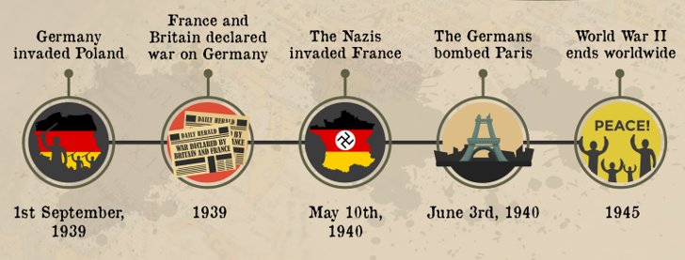
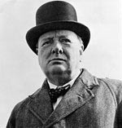
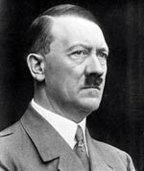
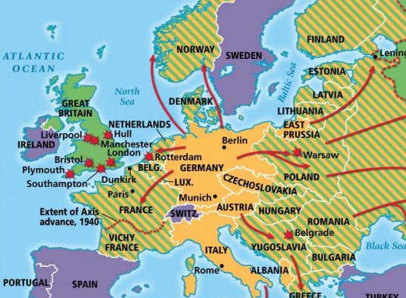
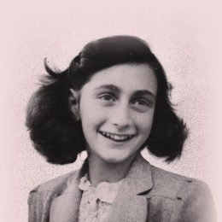
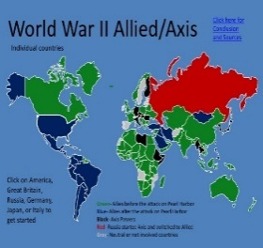
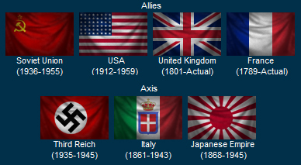
History Knowledge Organiser
Year 6 – Autumn Term 1
A Turning Point in Time - Was the Blitz the most significant part of WW2?
Knowledge and key information: We will learn about the different events of World War 2 (WW”). We will know how WW2 impacted Great Britain, including the Blitz.
Significant Figures
Tier 2 Vocabulary
Duration – how long something lasts.
Sequence – the order something follows
Chronological –following the order in which they occur
War – a state of armed conflict between different countries or different groups within a country.
Key Events Timeline
New skills
Use timelines to place events, periods, and cultural movements from around the world and use these as a reference point Use words and phrases for movements or times of change Choose reliable sources of factual evidence to describe aspects of life, people's beliefs and attitudes and differences in status Identify how aspects of life have changed during a time period and give reasons why backing it up with evidence and statistics. Describe how some changes impact both on subsequent periods, and, in the long term, on today's society Form own opinions about historical events from a range of sources. Present information in an organised and clearly structured way and in the most effective/appropriate manner
Winston Churchill
Adolf Hitler
1 September 1939 – 2 September 1945
Tier 3 Key Vocabulary
Allies- countries (including Britain, France, the Soviet Union and the USA) who joined forces to fight the Axis Powers.
Axis Powers- Germany, Japan, Italy and other countries that were allies in World War 2.
Blackout - wartime ban on street lights and other lights at night
Blitz - German air raids, from a German word 'blitzkrieg' which means 'lightning war'.
Evacuee - Someone who was evacuated, moved from a danger area to a safer place.
Holocaust - Mass murder of Jews and other people by the Nazis
Nazi - Short for National Socialist Party (in Germany), a follower of Hitler was also called a Nazi
Propaganda - controlling news media (such as radio) to show your side in the best way
Anne Frank

