Slide 1

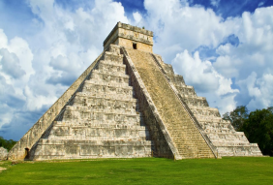
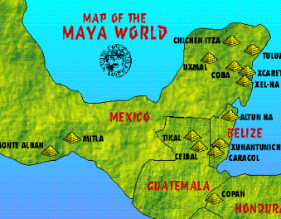
History Knowledge Organiser
Year 6 – Spring Term 1
Welcome to the Jungle! – What were the significant achievements of the Mayans?
Key Events Timeline
1100 B.C. | 800 B.C. | 400 B.C. | 300 B.C. | 100 B. C. | 600 A.D. | 800 A.D. | 900 A.D. | 1502 A.D. | 1100 B.C.
The first hunter-gatherers on the pacific coast | Village farming and trade become established | First solar calendars invented | Cities become centres for trade and kings begin to rule | First pyramids are built | Cities start expanding quickly | Building of stepped pyramid of Chichen-Itza | Decline of Mayan cities | First contact with Europeans is made | The first hunter-gatherers on the pacific coast
Knowledge and key information: The Maya believed in and worshipped a number of different gods. They believed that the gods had a good side and a bad side and that the gods could help or hurt them. The Maya would dance, sing and sometimes make offerings of blood to the gods. The Maya people believed that the Earth, which they called the Middleworld, was large and flat and resting on the back of a creature, such as a turtle or crocodile. On the Middleworld grew a tree whose branches reached up into the heavens (the Upperworld) and whose roots grew down into Xibalba (the Underworld), which was guarded by gods of death who looked like jaguars. Mayans believed that, after they died, their souls would travel through a series of caves and tunnels to Xibalba. The Maya writing system, used to write several different Maya languages, was made up of over 800 symbols called glyphs. The Maya also developed a complex number and counting system that was advanced for their time.
Tier 2 Vocabulary
Ahau - the main king or lord of a Maya city
archaeologist – a person who studies human history through the discovery and analysis of sites and artefacts
artefact - an object that is made by a person, such as a tool or a decoration, especially one that is of historical interest.
Batab - A lesser lord, usually ruling over a small town.
civilisation - a society of people with its own culture and way of life
cenote - a sinkhole filled with water. These were both sources of water and a place for sacrifice
Tier 3 Vocabulary
Codex - a book written by the Maya that was created on one long sheet of paper and folded
dynasty - a series of rulers or leaders who are all from the same family, or a period when a country is ruled by them
Haab' - The Maya solar calendar that was used to measure time and had 365 days.
hieroglyphics - a system of writing using pictures not words
Kukulcan - The serpent god of the Maya. One of the primary gods, especially to the Itza peoples of Chichen Itza.
maize - maize, also known as corn, is a cereal grain
Tzolk'in - The Maya religious calendar used to track religious days and ceremonies. It had 260 days
Chichen Itza
New skills
Use timelines to place events, periods, and cultural movements from around the world and use these as a reference point Use key timelines to demonstrate changes and development in 1 key area: culture (art), technology, or religion. Identify how aspects of life have changed during a time period and give reasons why backing it up with evidence and statistics. Describe how some changes impact both on subsequent periods, and, in the long term, on today's society. Form own opinions about historical events from a range of sources. Select the most appropriate source material, using primary and secondary, for a particular task

